Slide 1

simsem: SIMulated Structural Equation Modeling in R
Alexander M. Schoemann
Sunthud Pornprasertmanit
Patrick J. Miller

Slide 2
Monte Carlo Simulations
Monte Carlo simulations are a popular tool for methodologists with many uses
Determine the accuracy of new methods
Compare different methods
Perform power analyses
Determine model fit in SEM

Slide 3
Monte Carlo Simulations
General steps in a Monte Carlo Simulation
Specify population parameters
Create a sample of size N, based on population parameters
Analyze sample data from step 2 with chosen statistical method(s).
Repeat steps 2 and 3 for each of r replications.

Slide 4
Software options for Monte Carlo Simulations with SEM
Mplus
EQS
PRELIS/LISREL
SAS (not automated)
lavaan (not automated)
Other R packages (sem, OpenMx) (not automated)
Others?

Slide 5
simsem
A new R package designed to automate Monte Carlo Simulations using SEM
simsem can:
Generate data
Modify generated data
Analyze data
Summarize results
Use multiple processors across simulations

Slide 6
simsem Features
Data generation
Currently only continuous data are generated.
By default data are generated from a multivariate normal distribution
Both manifest and latent variables can have non-normal distributions
Data can be generated from a covariance matrix and mean vector or through a series of linear equations.

Slide 7
simsem Features
Data generation (continued)
Data can be generated with population misfit
Data can be generated with continuously varying parameters
Generating and analysis models are specified using LISREL matrices

Slide 8
simsem Features
Data modification
Many type of missing data mechanisms can be simulated
MCAR
MAR
Planned missing data designs
“3” Form Design
“2” Method Design

Slide 9
simsem Features
Data analysis
All models are fit using lavaan
Robust ML estimators are available
FIML is used when data are missing
Equality constraints can be included
Multiple imputation of missing data is performed with Amelia
Data are imputed, analyzed and results are combined with Rubin’s Rules for each replication

Slide 10
simsem Features
Summarizing Results
Results from a simulation can be automatically summarized
Results for each model parameter include:
Parameter bias
Standard error bias
Confidence interval coverage
Power

Slide 11
Example 1: Power Analysis
Given population parameters, what sample size will result in a given level of power (e.g., .80)?
Continuously varying sample size approach
Specify model and a range of sample sizes
Generate 2000+ replications varying sample size across replications
Record each parameter’s significance for each replication (0 not sig., 1 sig.)

Slide 12
Example 1: Power Analysis
Given population parameters, what sample size will results in a given level of power (e.g., .80)?
Continuous approach
Use logistic regression to predict a parameter’s significance (across all replications) from the sample size of each replication.
The predicted probability from the logistic regression at a given N is power for that parameter at that N

Slide 13
Example 1: Power Analysis
.1
F1
F2
1*
1*
.7
.7
.7
.7
.7
.7
Y1
Y2
Y3
Y4
Y5
Y6
.51
.51
.51
.51
.51
.51

Slide 14
Example 1: Power Analysis

Slide 15
Example 1: Power Analysis
Results: What sample size results in power for the latent correlation of .80?
Continuous approach
3000 replications, randomly varying N between 100-2000
logit(power) = β₀ + β₁N
Power = .80 when N = 1436

Slide 16
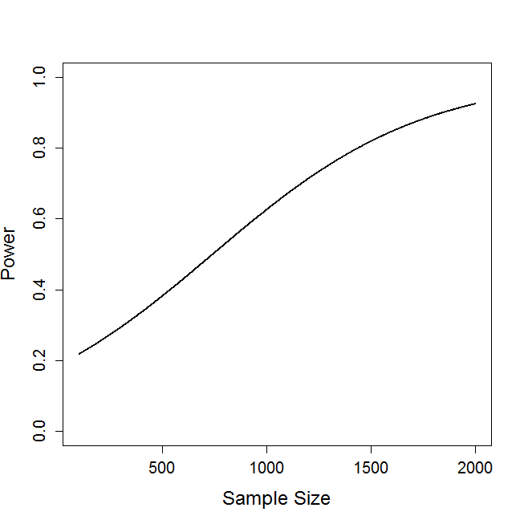

Slide 17
Example 2: Planned Missing Data Design
Investigate power and bias in a 3 form planned missing data design
Form | Common Set X | Variable Set A | Variable Set B | Variable Set C
1 | ¼ of items | ¼ of items | ¼ of items | Missing
2 | ¼ of items | ¼ of items | Missing | ¼ of items
3 | ¼ of items | Missing | ¼ of items | ¼ of items

Slide 18
Example 2: Planned Missing Data Design
.1
F1
F2
1*
1*
.7
.7
.7
.7
.7
.7
Y1
Y2
Y3
Y4
Y5
Y6
.51
.51
.51
.51
.51
.51

Slide 19
Example 2: Planned Missing Data Design
Planned missing design:
X block:Y1 and Y4
A block: Y2 and Y5
B blockY3
C Block: Y4
Missing data is handled thought 5 imputations in Amelia
N = 500
1000 replications

Slide 20
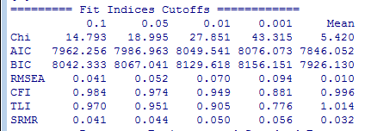
Example 2: Results

Slide 21
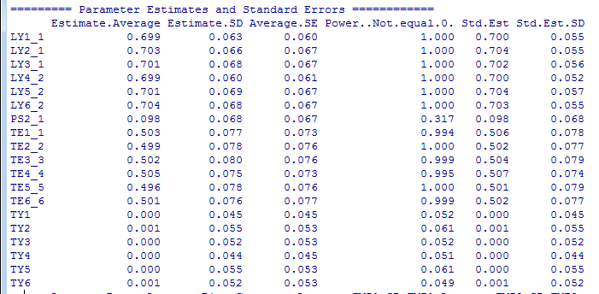
Example 2: Results

Slide 22
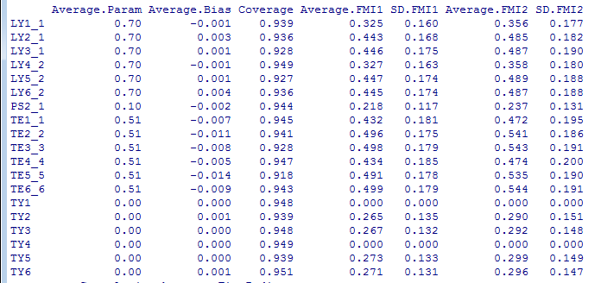
Example 2: Results

Slide 23
Some Future Plans
Multiple group models (coming soon!)
Categorical indicators
Multilevel SEM
Non-linear constraints
Additional analysis (e.g., OpenMx) and imputation packages (e.g, Mice)
Latent interactions
Automate parceling of indicators
Syntax entry

Slide 24
Also…
Another R package that may interest R users familiar with SEM
semTools
Useful tools for conducting SEM in R
e.g., runMI, imputes missing data, runs each imputed data set, and combines results
An open source, community supported package
Have an idea for a function? Or a way to improve an existing function? Let us know!

Slide 25
Questions?
Thanks to
Paul Johnson
Todd Little
simsem: simsem.org
example code available at: simsem.org
email: schoemann@ku.edu
Partial support provided by NSF grant 1053160 (Wei Wu & Todd D. Little, co-PIs)

